Slide 1
The evolution of AI

Slide 2
Presentation plan
First attempts to create AI
Key stages of development
What is AI today?
Conclusion

Slide 3

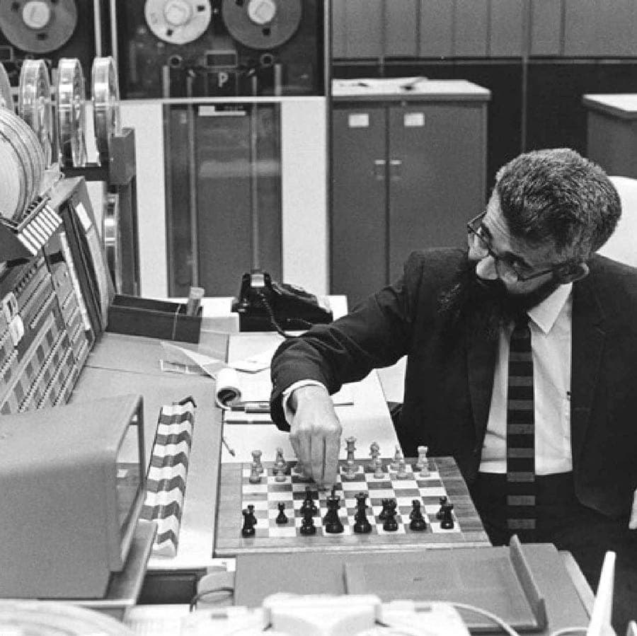
First attempts to create AI

Slide 4
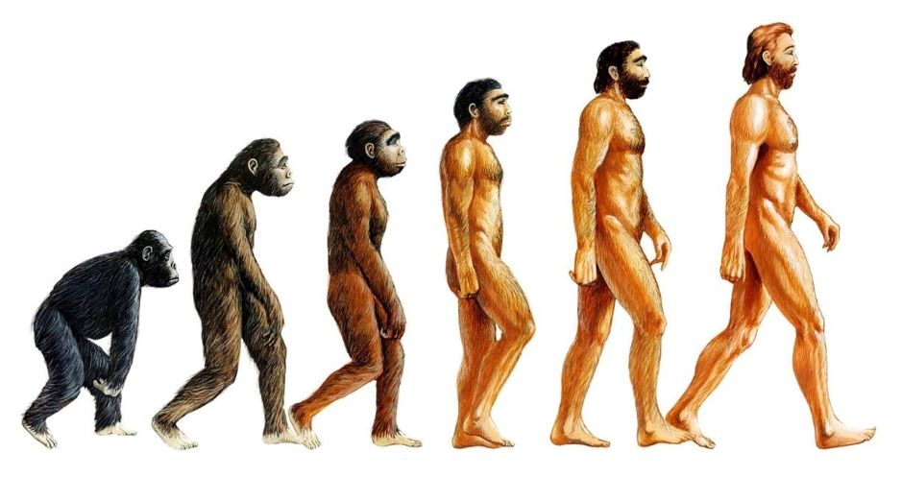
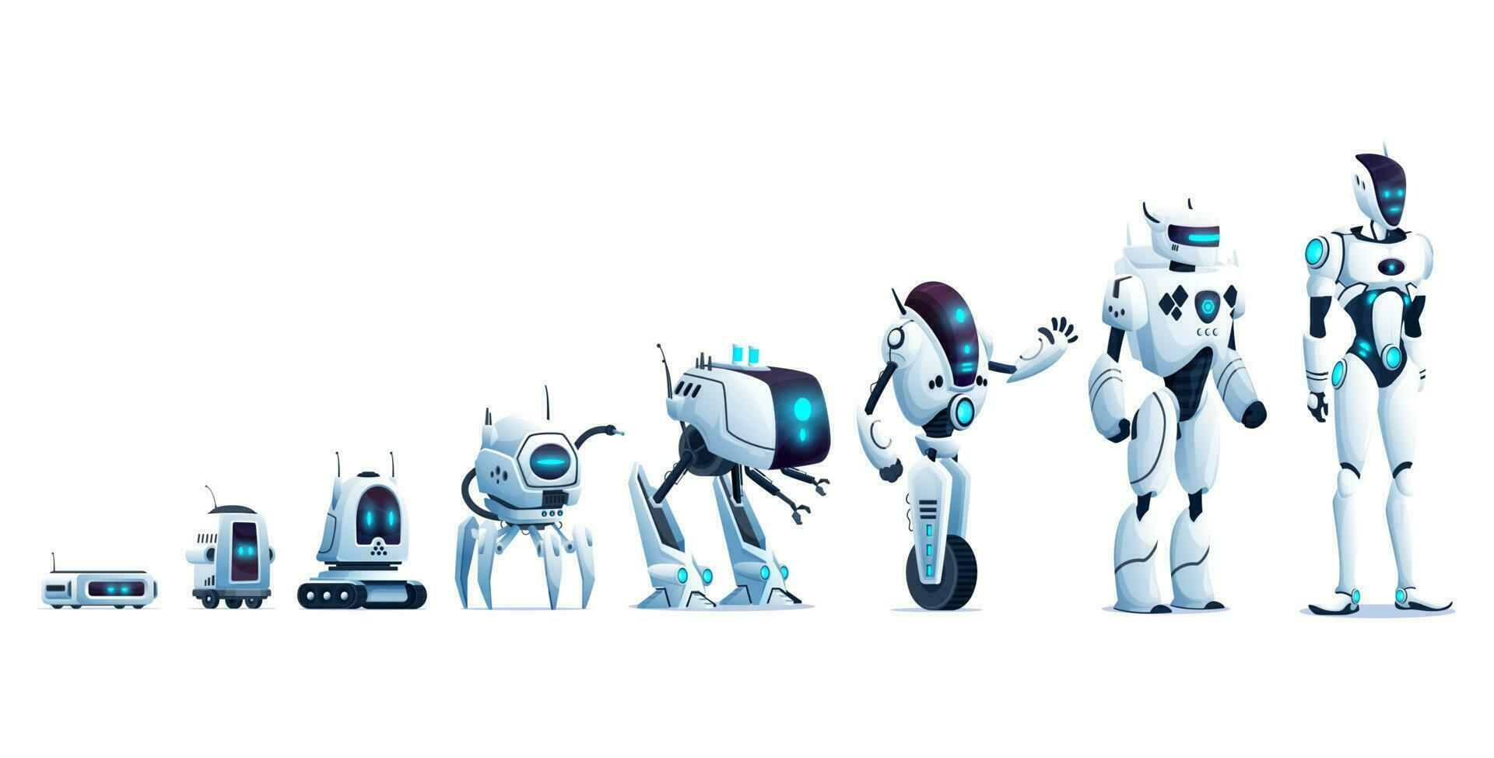
Key stages of development
Symbolic AI (1950s-1980s)
Statistical Learning (1980s-2010s)
Deep Learning (2010s-Present)
Generative AI & Foundation Models (Present)

Slide 5


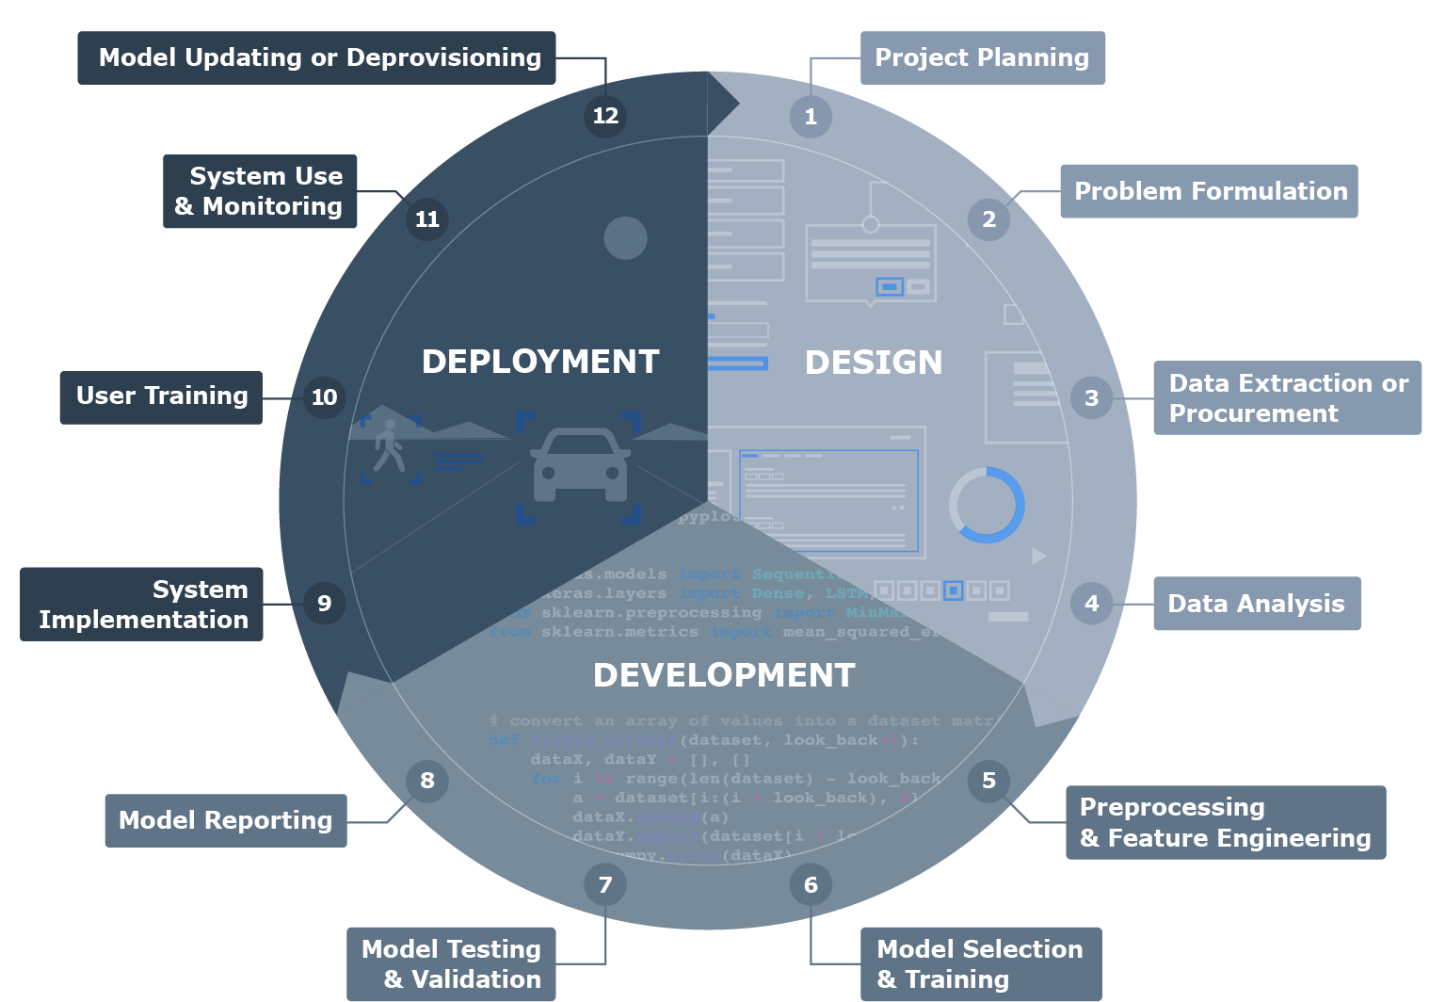





What is AI today?

Slide 6
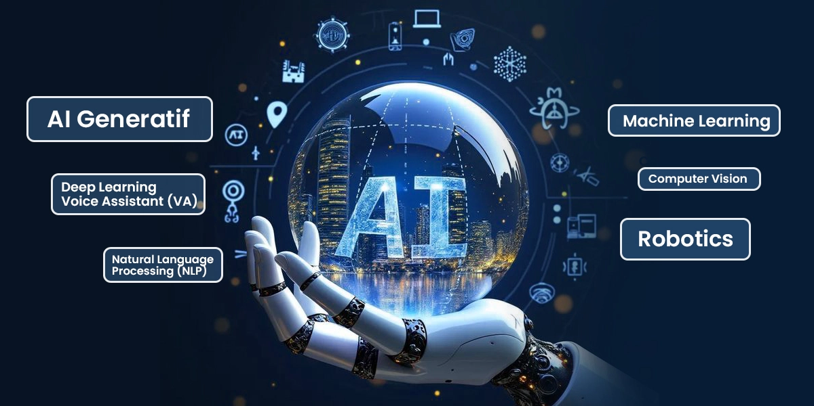
Conclusion

Slide 7
Thank you for your attention!

